Slide 1

Non-Parametric Estimation of Multivariate Marked Hawkes Process Presentation for Recent Trends in Quantitative Finance
Sobin Joseph and Shashi Jain
Department of Management studies
IISc Bangalore
13-02-2024

Slide 2
Contents
Marked Hawkes process
Intensity function of Marked Hawkes Process
Estimation of Marked Hawkes Process
Synthetic and Real Data Experiments

Slide 3
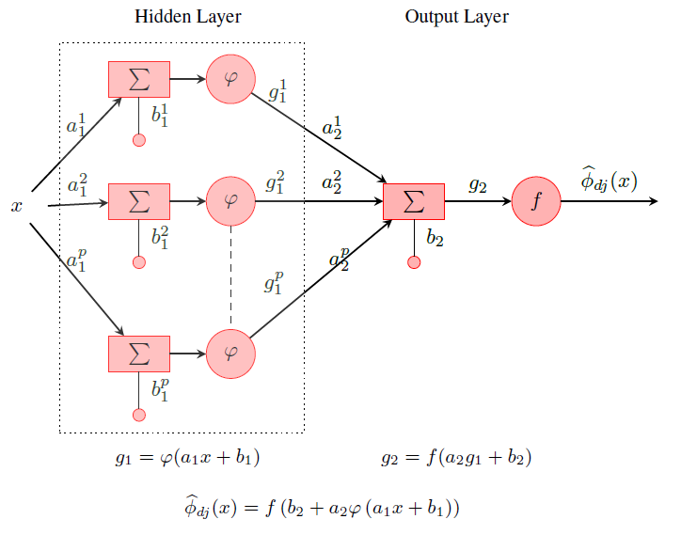
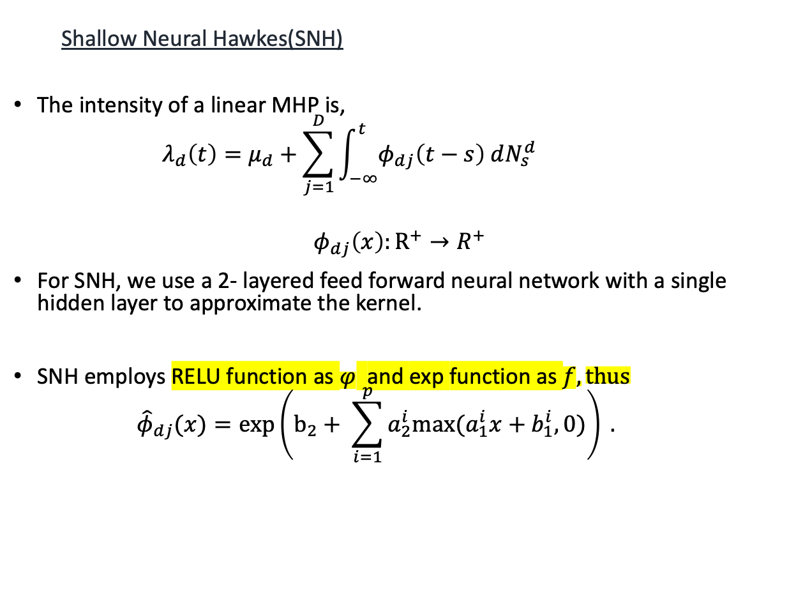
Prerequisites
Shallow Neural Hawkes(SNH)
The intensity of a linear MHP is,
$$λ_{d}\left(t\right)=μ_{d}+\sum_{j=1}^{D}{\int_{−∞}^{t}{φ_{dj}\left(t−s\right) dN_{s}^{d} }}$$
$$φ_{dj}\left(x\right):R^{+}→R^{+}$$
For SNH, we use a 2- layered feed forward neural network with a single hidden layer to approximate the kernel.
SNH employs RELU function as $φ$ and exp function as $f, thus$
$${\hat{φ}}_{dj}(x)=\exp\left(b_{2}+ \sum_{i=1}^{p}{a_{2}^{i}max⁡(a_{1}^{i}x+b_{1}^{i},0)}\right) .$$
Fig: Neural Network Architecture

Slide 4
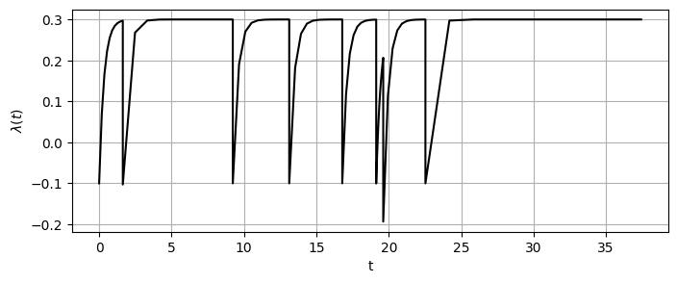
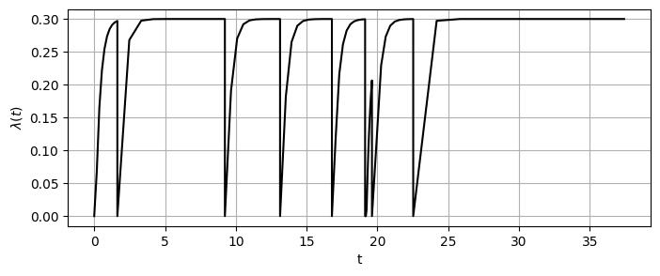
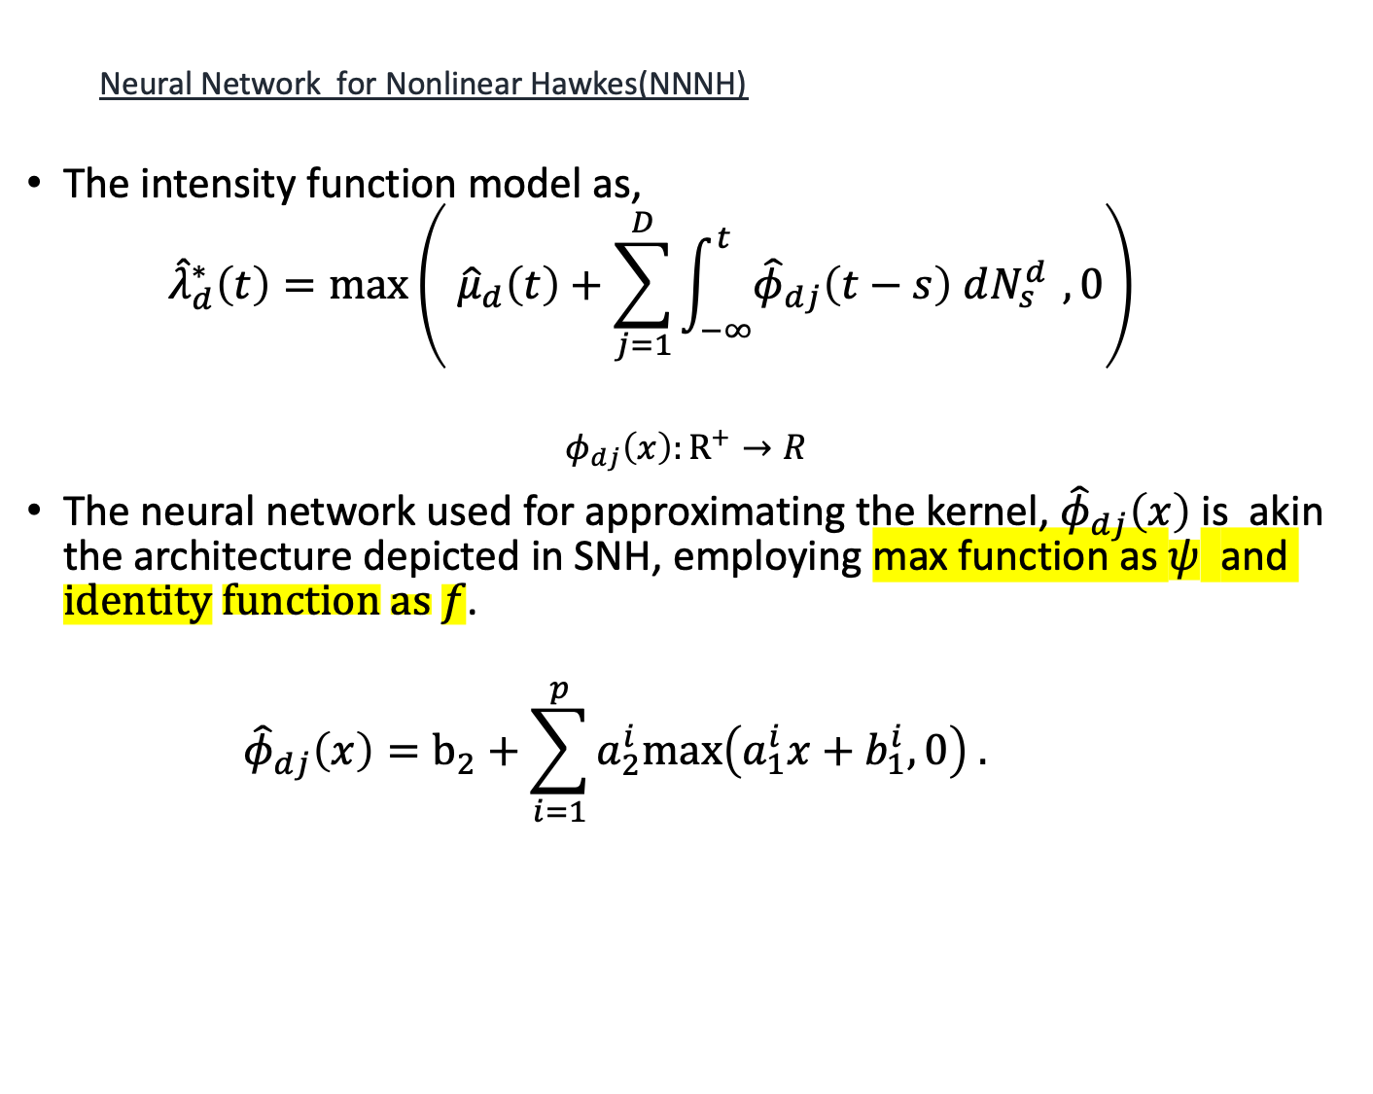
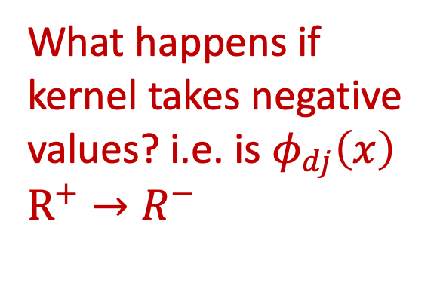
Prerequisite
Neural Network for Nonlinear Hawkes(NNNH)
The intensity function model as,
$${\hat{λ}}_{d}^{∗}\left(t\right)=max\left( {\hat{μ}}_{d}\left(t\right)+\sum_{j=1}^{D}{\int_{−∞}^{t}{{\hat{φ}}_{dj}\left(t−s\right) dN_{s}^{d }}},0\right)$$
$$φ_{dj}\left(x\right):R^{+}→R$$
The neural network used for approximating the kernel, ${\hat{φ}}_{dj}\left(x\right)$ is akin the architecture depicted in SNH, employing max function as $ψ$ and $identity function as f$.
$${\hat{φ}}_{dj}\left(x\right)=b_{2}+\sum_{i=1}^{p}{a_{2}^{i}max\left(a_{1}^{i}x+b_{1}^{i},0\right) . }$$
What happens if kernel takes negative values? i.e. is $φ_{dj}\left(x\right)$ $R^{+}→R^{−}$

Slide 5
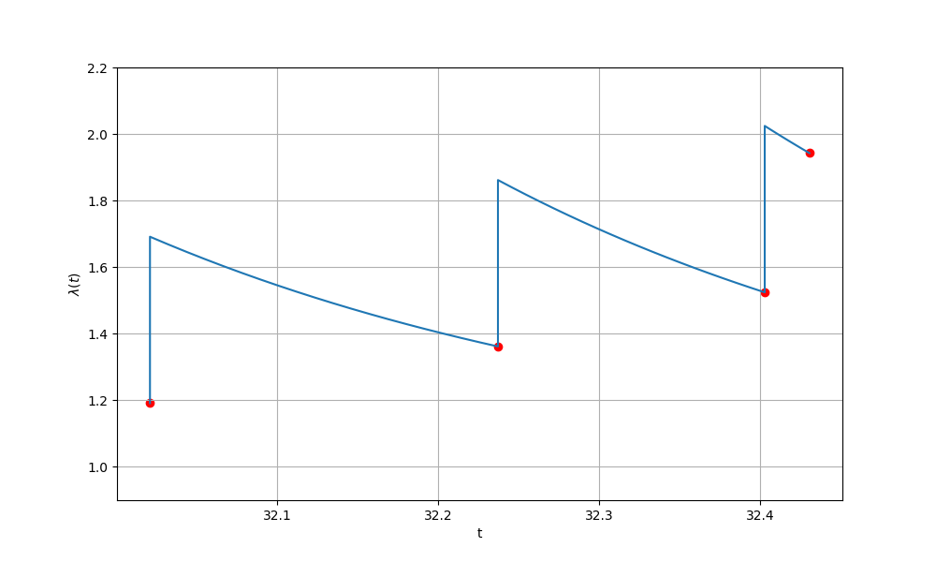
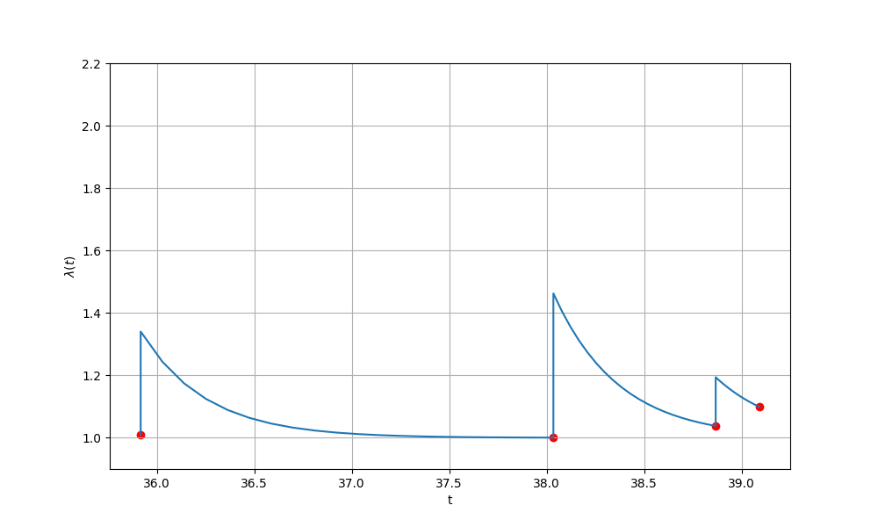
Marked Hawkes Process
Constant
Jumps
Non-Constant
Jumps
Fig: Intensity of Hawkes process
Fig: Intensity of Marked Hawkes process
A Hawkes process becomes a marked Hawkes process when its intensity is a function of time and mark (any quantity other than time). Examples of mark are volume or price in case of market orders, magnitude in case of earthquake.
In a Hawkes process, whenever an event occurs the impact by that event on intensity will always be a constant resulting in constant jumps, while in a Marked Hawkes process it will be varying.

Slide 6
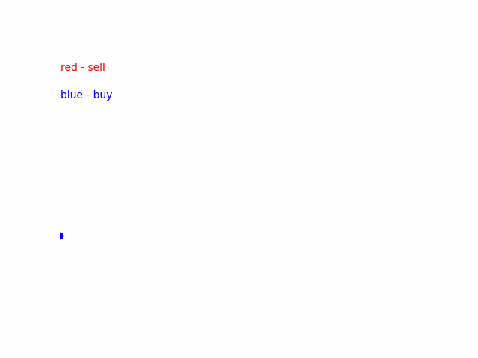
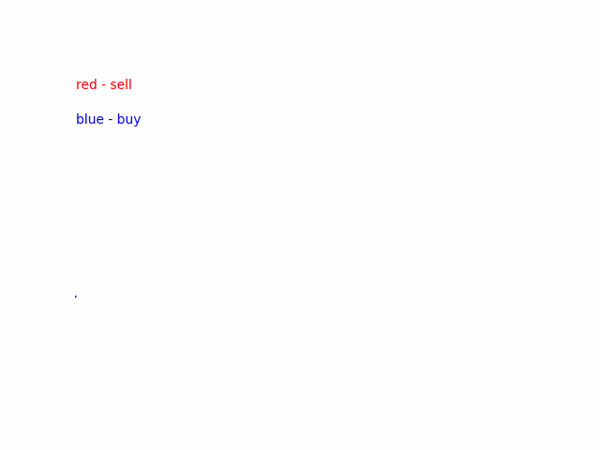
Need for Marked Hawkes Process
Earlier estimations of the Hawkes process only use past time stamps for modelling the subsequent arrivals.
Ogata[1999] found that there is also a dependency of the magnitude of the past aftershocks on the time of the next aftershock occurrence in case of an earthquake.
Earlier estimations regarding Hawkes in finance also concentrated on past time stamps, disregarding other factors that may affect future arrivals.
Chavez-Demoulin and McGill [2012], Fauth and Tudor [2012], Rambaldi et al. [2017] , and Fabre and Toke [2024] found that the volume of trade plays a prominent role in determining the clustering of the event.

Slide 7
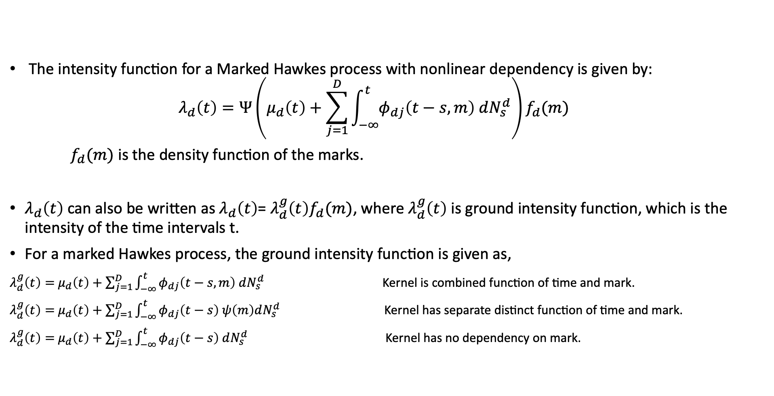
Intensity Function of Marked Hawkes Process
The intensity function for a Marked Hawkes process with nonlinear dependency is given by:
$$λ_{d}\left(t\right)=Ψ\left(μ_{d}\left(t\right)+\sum_{j=1}^{D}{\int_{−∞}^{t}{φ_{dj}\left(t−s,m\right) dN_{s}^{d}}}\right)f_{d}(m)$$
$f_{d}(m)$ is the density function of the marks.
$λ_{d}\left(t\right)$ can also be written as $λ_{d}\left(t\right)$= $λ_{d}^{g}\left(t\right)f_{d}(m)$, where $λ_{d}^{g}\left(t\right)$ is ground intensity function, which is the intensity of the time intervals t.
For a marked Hawkes process, the ground intensity function is given as,
$λ_{d}^{g}\left(t\right)=$ $μ_{d}\left(t\right)+\sum_{j=1}^{D}{\int_{−∞}^{t}{φ_{dj}\left(t−s,m\right) dN_{s}^{d}}}$ Kernel is combined function of time and mark.
$λ_{d}^{g}\left(t\right)=$ $μ_{d}\left(t\right)+\sum_{j=1}^{D}{\int_{−∞}^{t}{φ_{dj}\left(t−s\right) ψ\left(m\right)dN_{s}^{d}}}$ Kernel has separate distinct function of time and mark.
$λ_{d}^{g}\left(t\right)=$ $μ_{d}\left(t\right)+\sum_{j=1}^{D}{\int_{−∞}^{t}{φ_{dj}\left(t−s\right) dN_{s}^{d}}}$ Kernel has no dependency on mark.

Slide 8
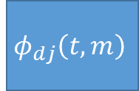
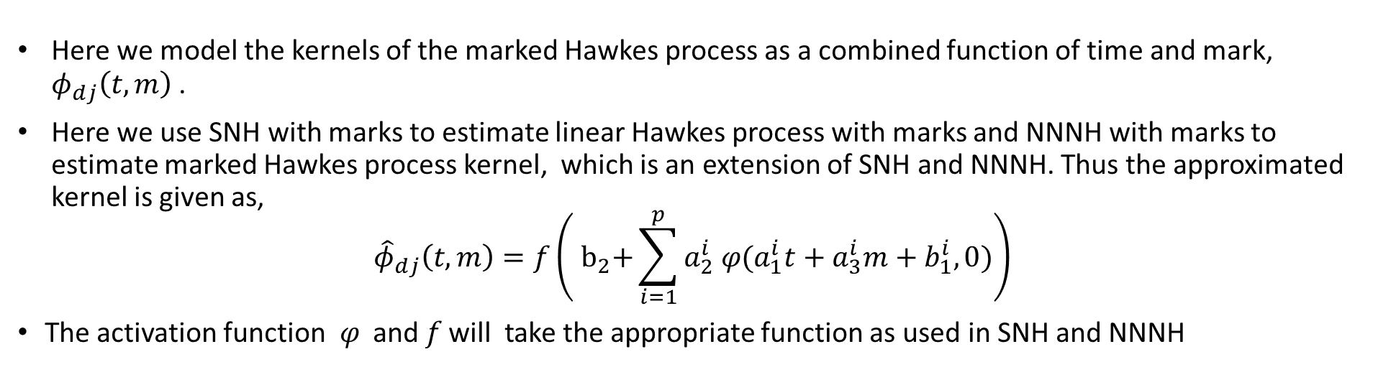
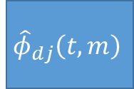
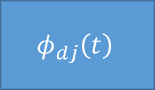
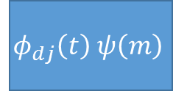
Estimation of Marked Hawkes Kernel
$$φ_{dj}\left(t,m\right)$$
$$φ_{dj}\left(t\right) ψ\left(m\right)$$
$${\hat{φ}}_{dj}\left(t,m\right)$$
$$φ_{dj}\left(t\right)$$
Here we model the kernels of the marked Hawkes process as a combined function of time and mark, $φ_{dj}\left(t,m\right)$ .
Here we use SNH with marks to estimate linear Hawkes process with marks and NNNH with marks to estimate marked Hawkes process kernel, which is an extension of SNH and NNNH. Thus the approximated kernel is given as,
$${\hat{φ}}_{dj}\left(t,m\right)=f\left({ b}_{2}+\sum_{i=1}^{p}{a_{2}^{i} φ(a_{1}^{i}t+a_{3}^{i}m+b_{1}^{i},0)}\right)$$
The activation function 𝜑 and 𝑓 will take the appropriate function as used in SNH and NNNH

Slide 9
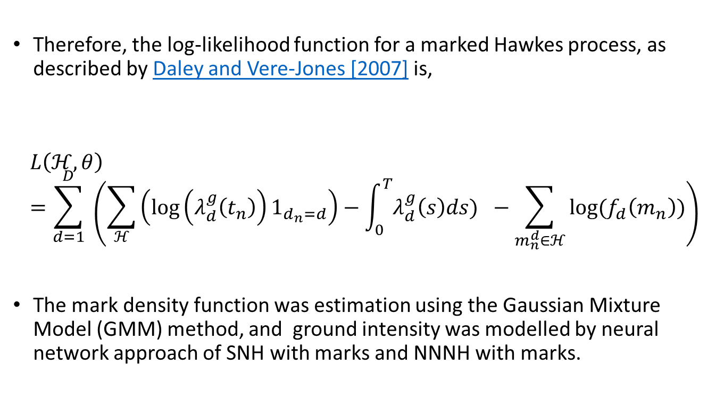
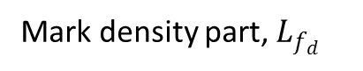
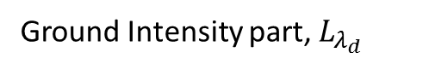
Likelihood Function of a Marked Hawkes Process
Therefore, the log-likelihood function for a marked Hawkes process, as described by Daley and Vere-Jones [2007] is,
$$L\left(ℋ, θ\right)=\sum_{d=1}^{D}{ \left(\sum_{ℋ}{\left(\log\left(λ_{d}^{g}\left(t_{n}\right)\right)1_{d_{n}=d}\right)−\int_{0}^{T}{λ_{d}^{g}\left(s\right)ds) }}−\sum_{m_{n}^{d}∈ℋ}{{log(f}_{d}\left(m_{n}\right))}\right)}$$
The mark density function was estimation using the Gaussian Mixture Model (GMM) method, and ground intensity was modelled by neural network approach of SNH with marks and NNNH with marks.
Ground Intensity part, $L_{λ_{d}}$
Mark density part, $L_{f_{d}}$

Slide 10
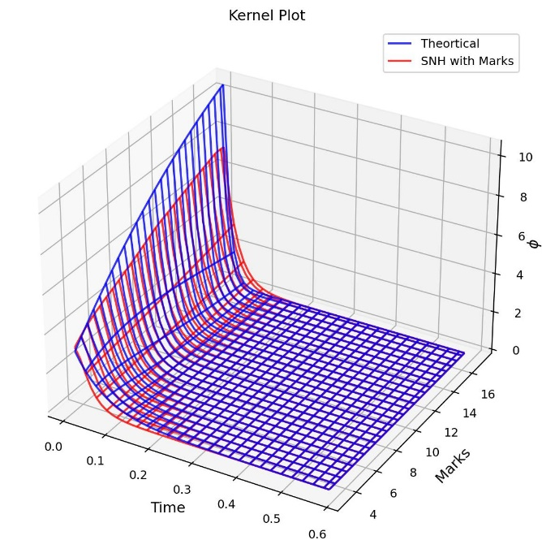
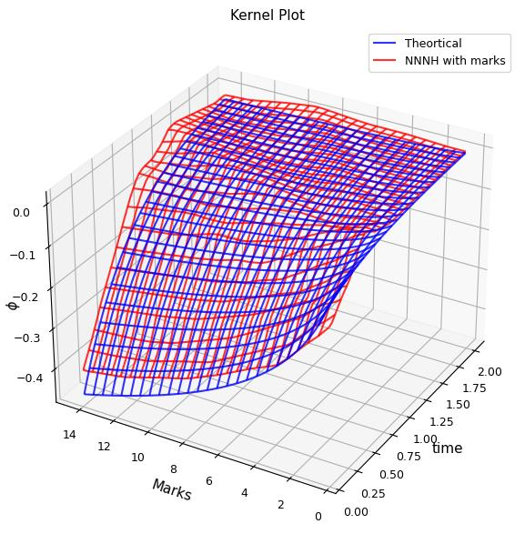
Synthetic Data Estimation 1 D
Fig: Combined kernel function $φ\left(t,m\right)={me}^{\left\{−t\left(1 + 5m\right)\right\}},$ estimated using SNH with marks.
Fig: Negative kernel with separate function for $φ\left(t\right)ψ\left(m\right)=ln\left(m\right)x(−0.4e^{−2t}),$ estimated using NNNH with marks.

Slide 11
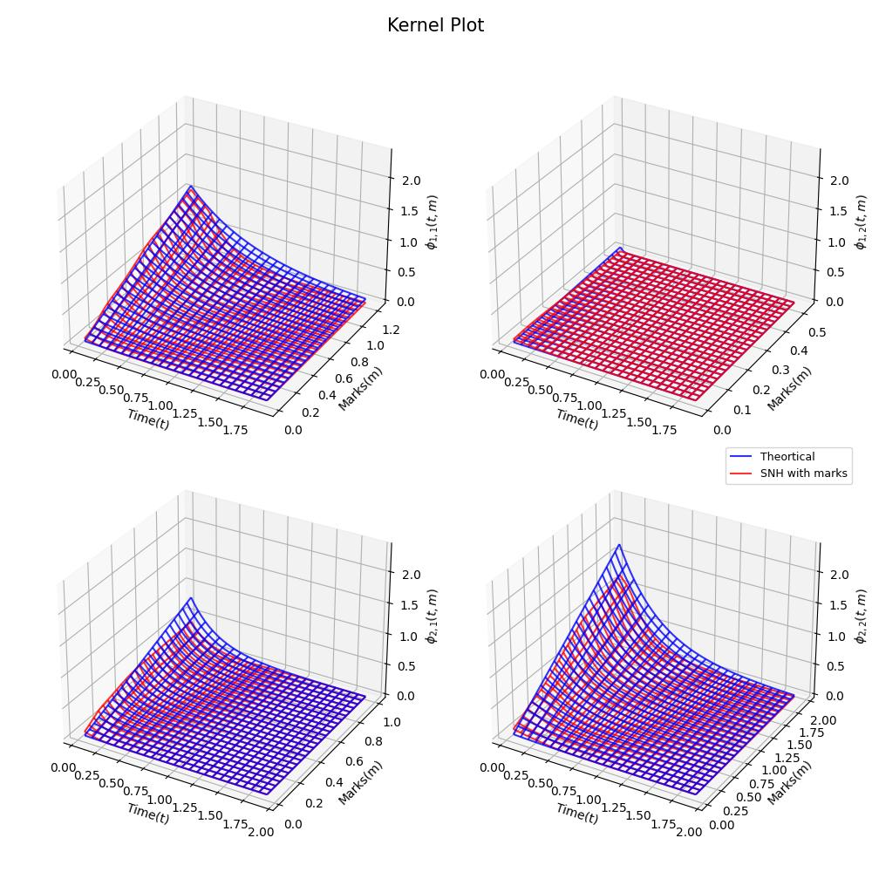
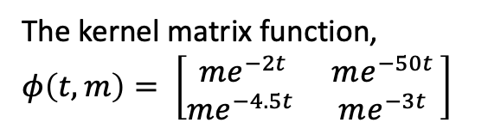
Synthetic Data Estinmation 2 D
The kernel matrix function, $φ\left(t,m\right)= \left[\begin{matrix}me^{−2t} & me^{−50t } \\ me^{−4.5t } & me^{−3t }\end{matrix}\right]$
Fig: Kernels for marked Hawkes with distinct function for mark and kernel.

Slide 12
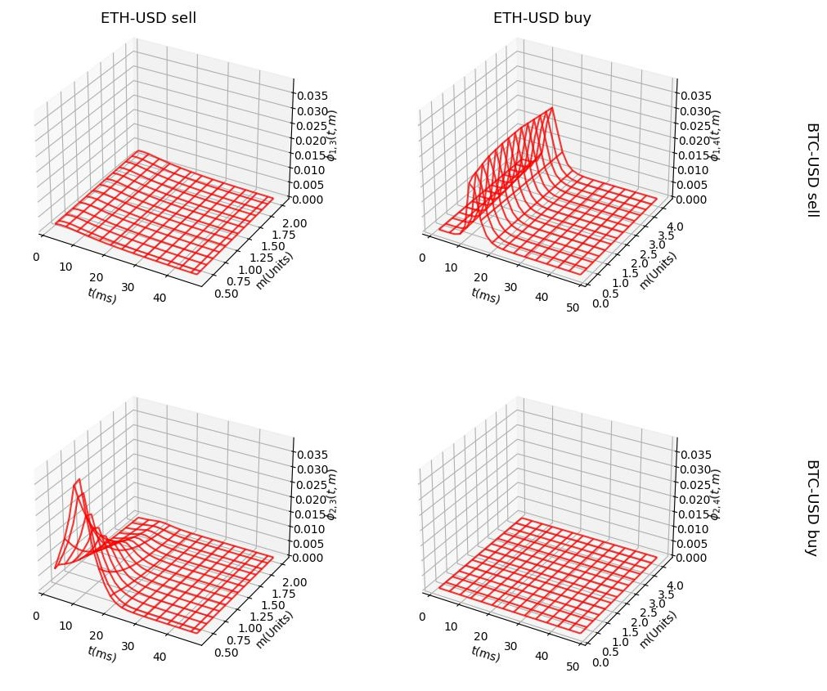
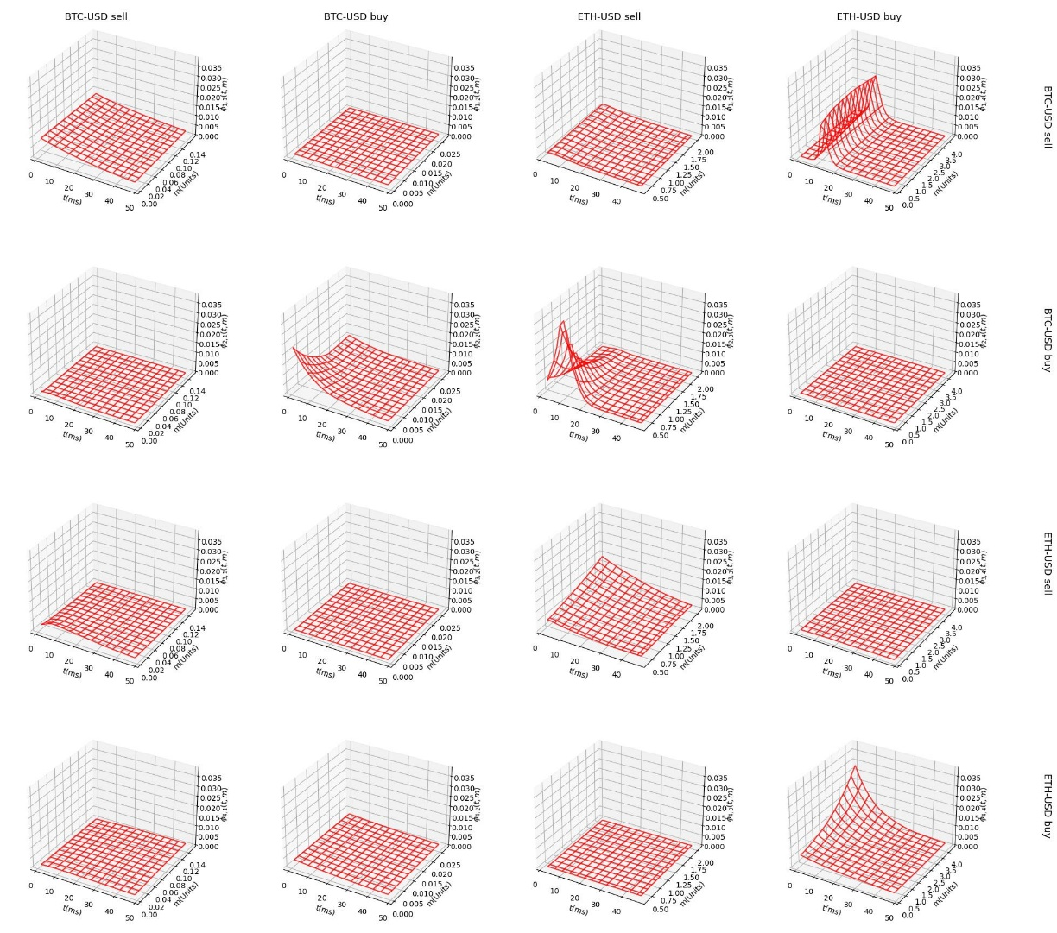
Application to Cryptocurrency
We employed the cryptocurrency dataset from 2:00 to 2:30 am on 12th July 2022.
In this case, the mark component considered is the ordered volume.
The estimation is done using SNH with marks.
From the kernels there is clear dependency on volume is observed for some kernels
There is observed cross dependency between the ETH Buy and BTC sell, and BTC buy and ETH sell.
Fig: Kernel plot of BTC-USD and ETH-USD market order data.

Slide 13
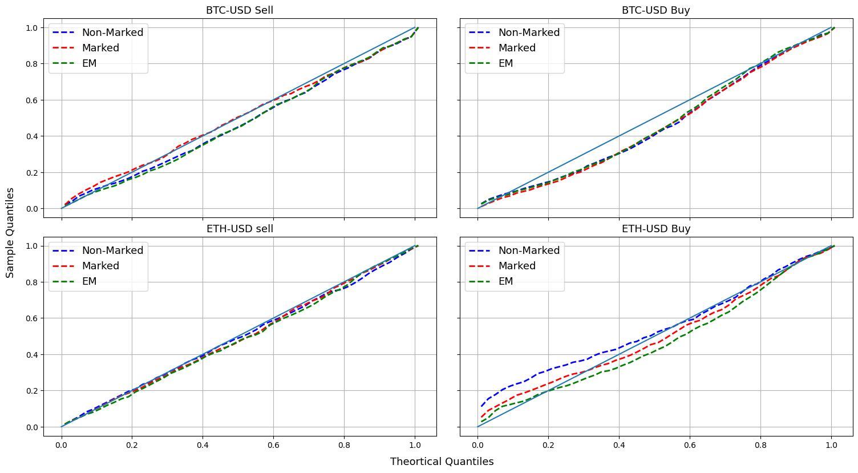
Conclusion
The proposed model employs a two-layer feed-forward neural network to approximate the Hawkes kernel, treating the kernel as a joint function of event times and their associated marks.
The NNNH with marks possesses the capability to model linear Hawkes models, we limit its use to scenarios suspected of negative dependencies.
In the cryptocurrency setting, estimation with marks reveals the relationship of the market order arrival intensity with the volume of the trade apart in addition to the history of trade arrivals. This is evident from the QQ plot.
Including spatial elements is a future area of focus in the model has the potential to enhance our understanding and prediction capabilities in earthquake modelling and related fields.
Fig: QQ plot comparing SNH with marks and vanilla SNH

Slide 14
Reference
Hawkes, Alan G. "Spectra of some self-exciting and mutually exciting point processes." Biometrika 58.1 (1971): 83-90.
Yosihiko Ogata. Seismicity analysis through point-process modeling: A review. In Seismicity patterns, their statistical significance and physical meaning, pages 471–507. Springer, 1999.
Marcello Rambaldi, Emmanuel Bacry, and Fabrizio Lillo. The role of volume in order book dynamics: a multivariate Hawkes process analysis. Quantitative Finance, 17(7):999–1020, 2017.
Erik Lewis and George Mohler. A nonparametric EM algorithm for multiscale Hawkes processes. Journal of Nonparametric Statistics, 1(1):1–20, 2011.
Sobin Joseph, Lekhapriya Dheeraj Kashyap, and Shashi Jain. Shallow neural Hawkes: Non-parametric kernel estimation for Hawkes processes. Journal of Computational Science, page 101754, 2022.
Valérie Chavez-Demoulin and JA McGill. High-frequency financial data modeling using hawkes processes. Journal of Banking & Finance, 36(12):3415–3426, 2012.
Angelos Dassios, Hongbiao Zhao, et al. Exact simulation of hawkes process with exponentially decaying intensity. Electronic Communications in Probability, 18, 2013.
Daryl J Daley and David Vere-Jones. An introduction to the theory of point processes: volume I: general theory and structure. Springer Science & Business Media, 2007.
Alexis Fauth and Ciprian A Tudor. Modeling first line of an order book with multivariate marked point processes. arXiv preprint arXiv:1211.4157, 2012.
Timothée Fabre and Ioane Muni Toke. Neural hawkes: Non-parametric estimation in high dimension and causality analysis in cryptocurrency markets. arXiv preprint arXiv:2401.09361, 2024.

Slide 15
Thank You
For more information contact
Mail id: sobinjoseph@iisc.ac.in
Phone no: 9497287072
Questions?

Slide 16
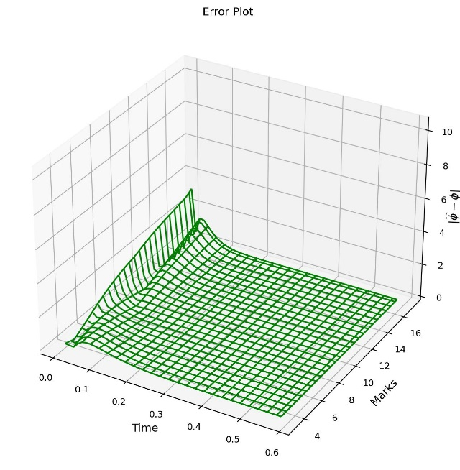
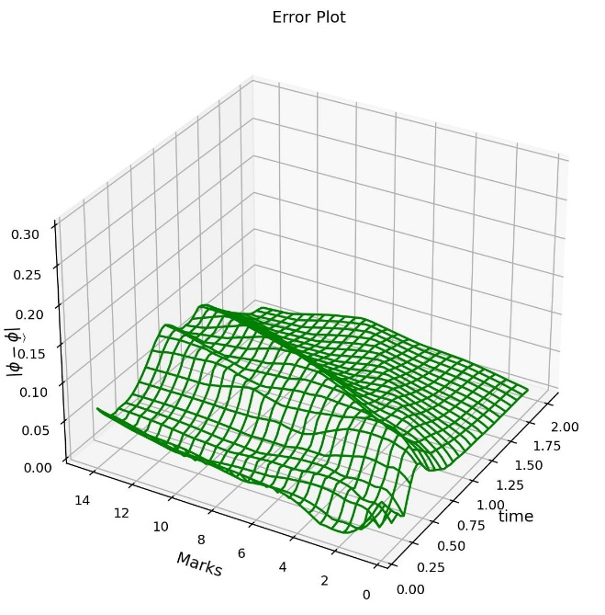
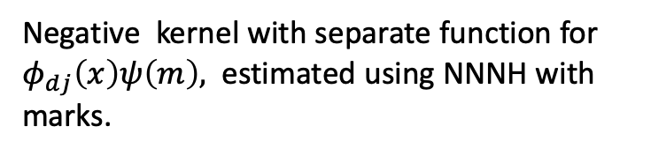
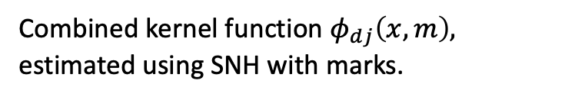
Synthetic Data for 1 D marked Hawkes
Combined kernel function $φ_{dj}\left(x,m\right),$ estimated using SNH with marks.
Negative kernel with separate function for $φ_{dj}\left(x\right)ψ\left(m\right),$ estimated using NNNH with marks.

Slide 17
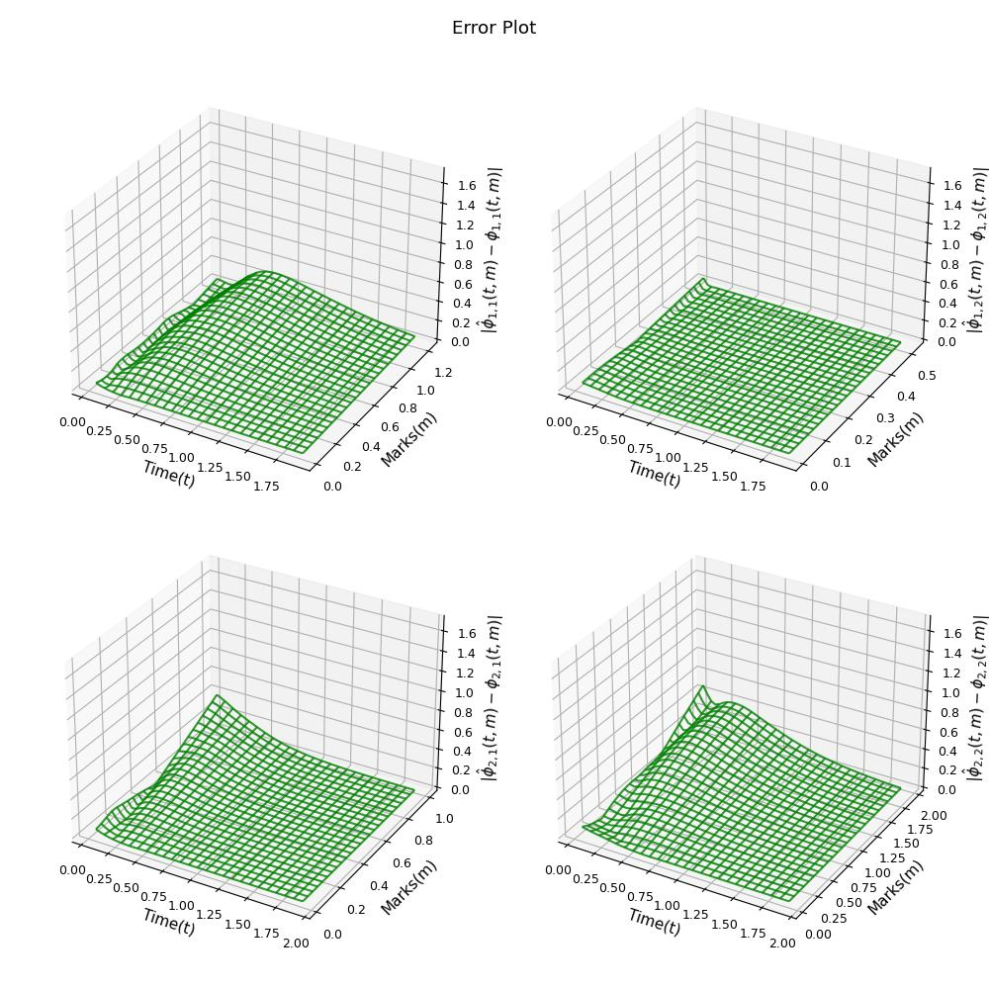
Synthetic Data for 2 D marked Hawkes
Here also we use a Distinct kernel function for time and marks

